Slide 1
IEC 61499: primer course
Module 3: IEC 61499 standard
Valeriy Vyatkin
Luleå University of Technology and Aalto University

Slide 2
Plan
What does it define?
Kinds of FBs, common elements: Interface, event, event-data association, data
Basic function block
Composite Function Block
Application / Subapplication
System

Slide 3
Example of a simple system FLASHER

Slide 4
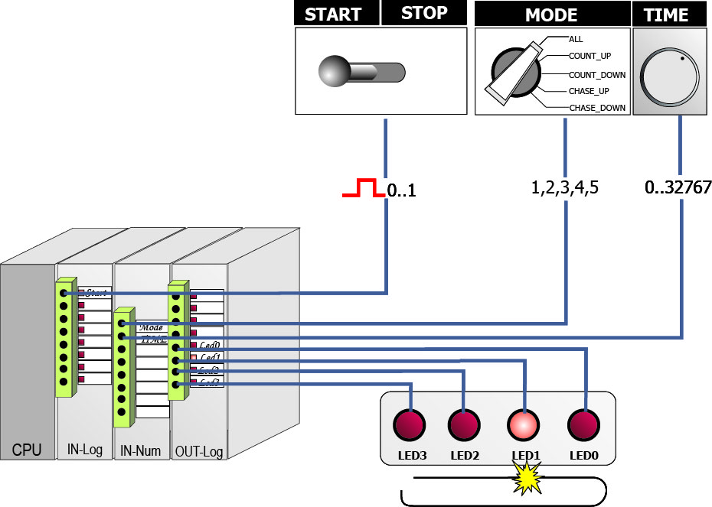
Example: FLASHER
Consider a simple product Flashing Lights
Components of the physical system:
PLC (CPU)
START/STOP Button
Mode Selection Switch
All lights on, count up, count down, chase up and chase down
Time Delay Nub
Delay between 2 consecutive light flashes
4 LEDs

Slide 5
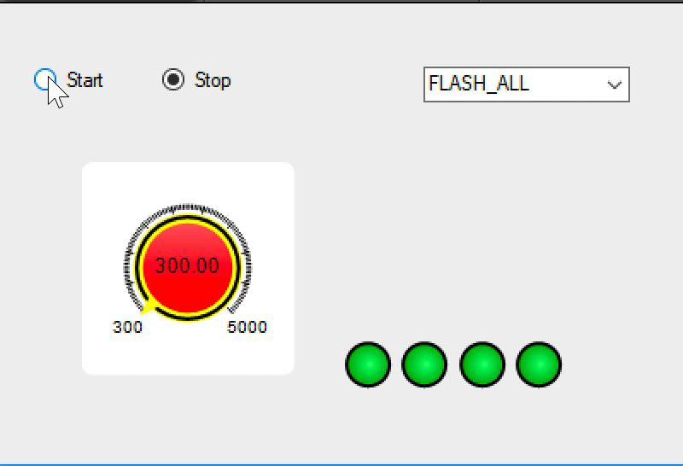
FLASHER modelled in software

Slide 6
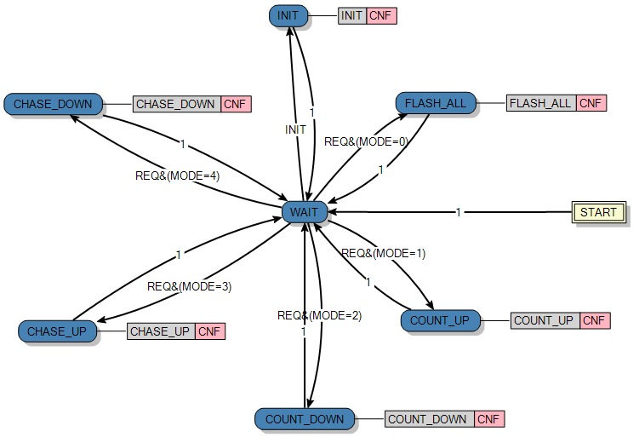
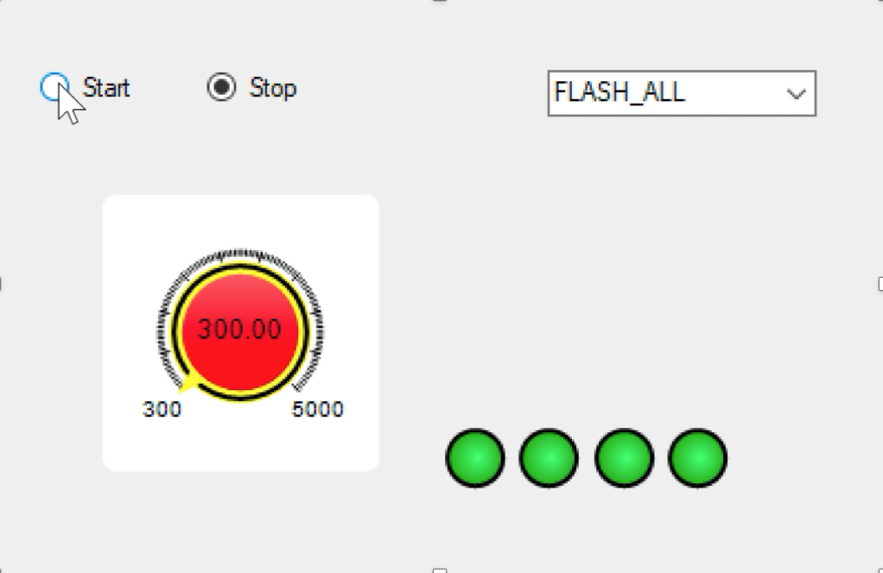
FLASHER application
The core functionality is captured in the FLASHER4 FB in a form of state machine

Slide 7

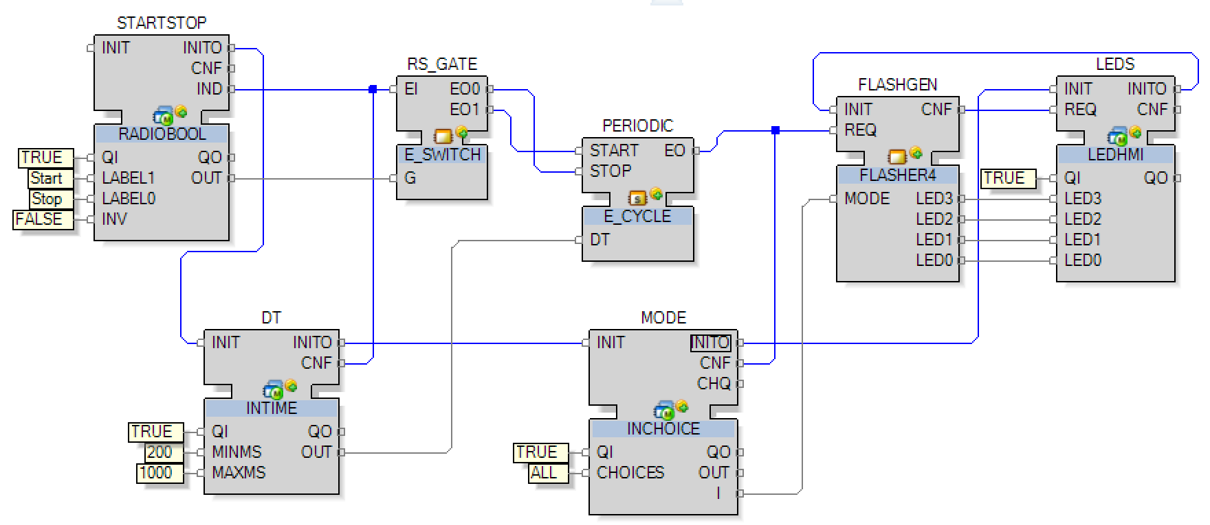
Model and simulate control logic with IEC 61499
HMI
Runs on a computer
Physical system
IEC 61499 executable model: Runs on PLC or PC (Soft PLC)

Slide 8
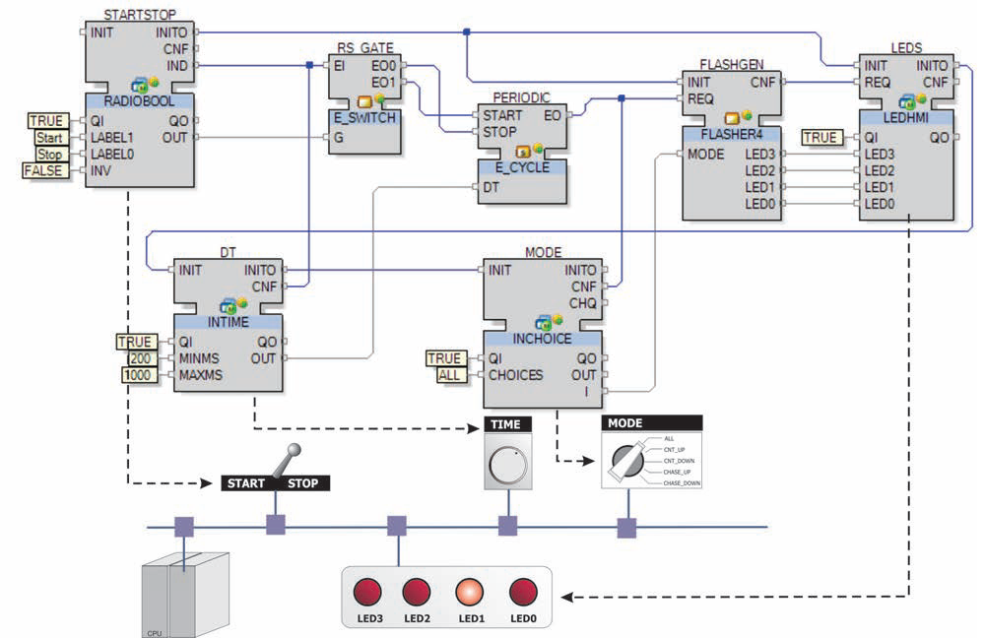
Distributed FLASHER
It is beneficial to model the functionalities in a hardware independent way.
Same block diagram can be executed on different types of controllers or even on a distributed hardware architecture (running on a network of PLCs).

Slide 9
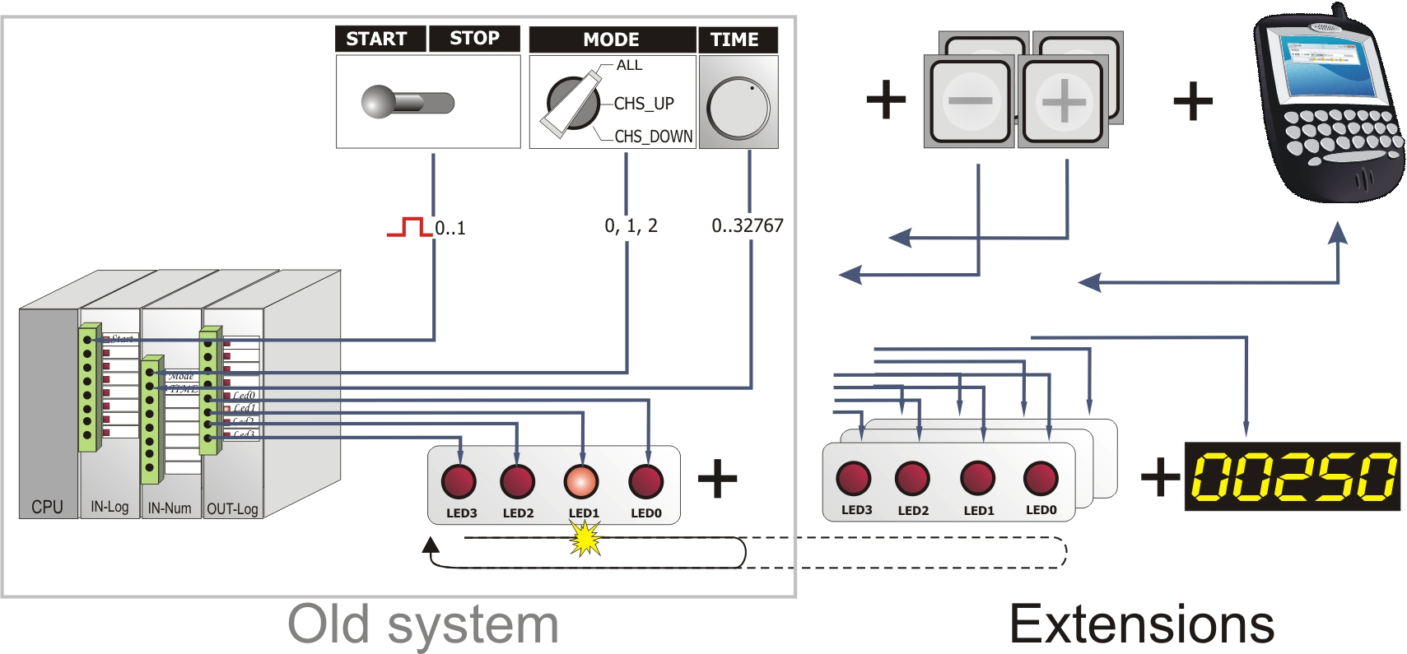
Motivation: Extensibility

Slide 10
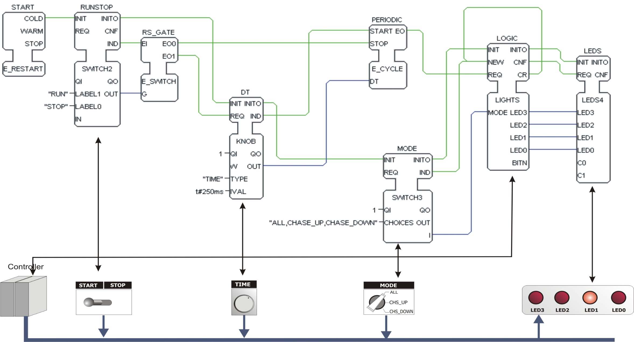
Distributed deployment

Slide 11
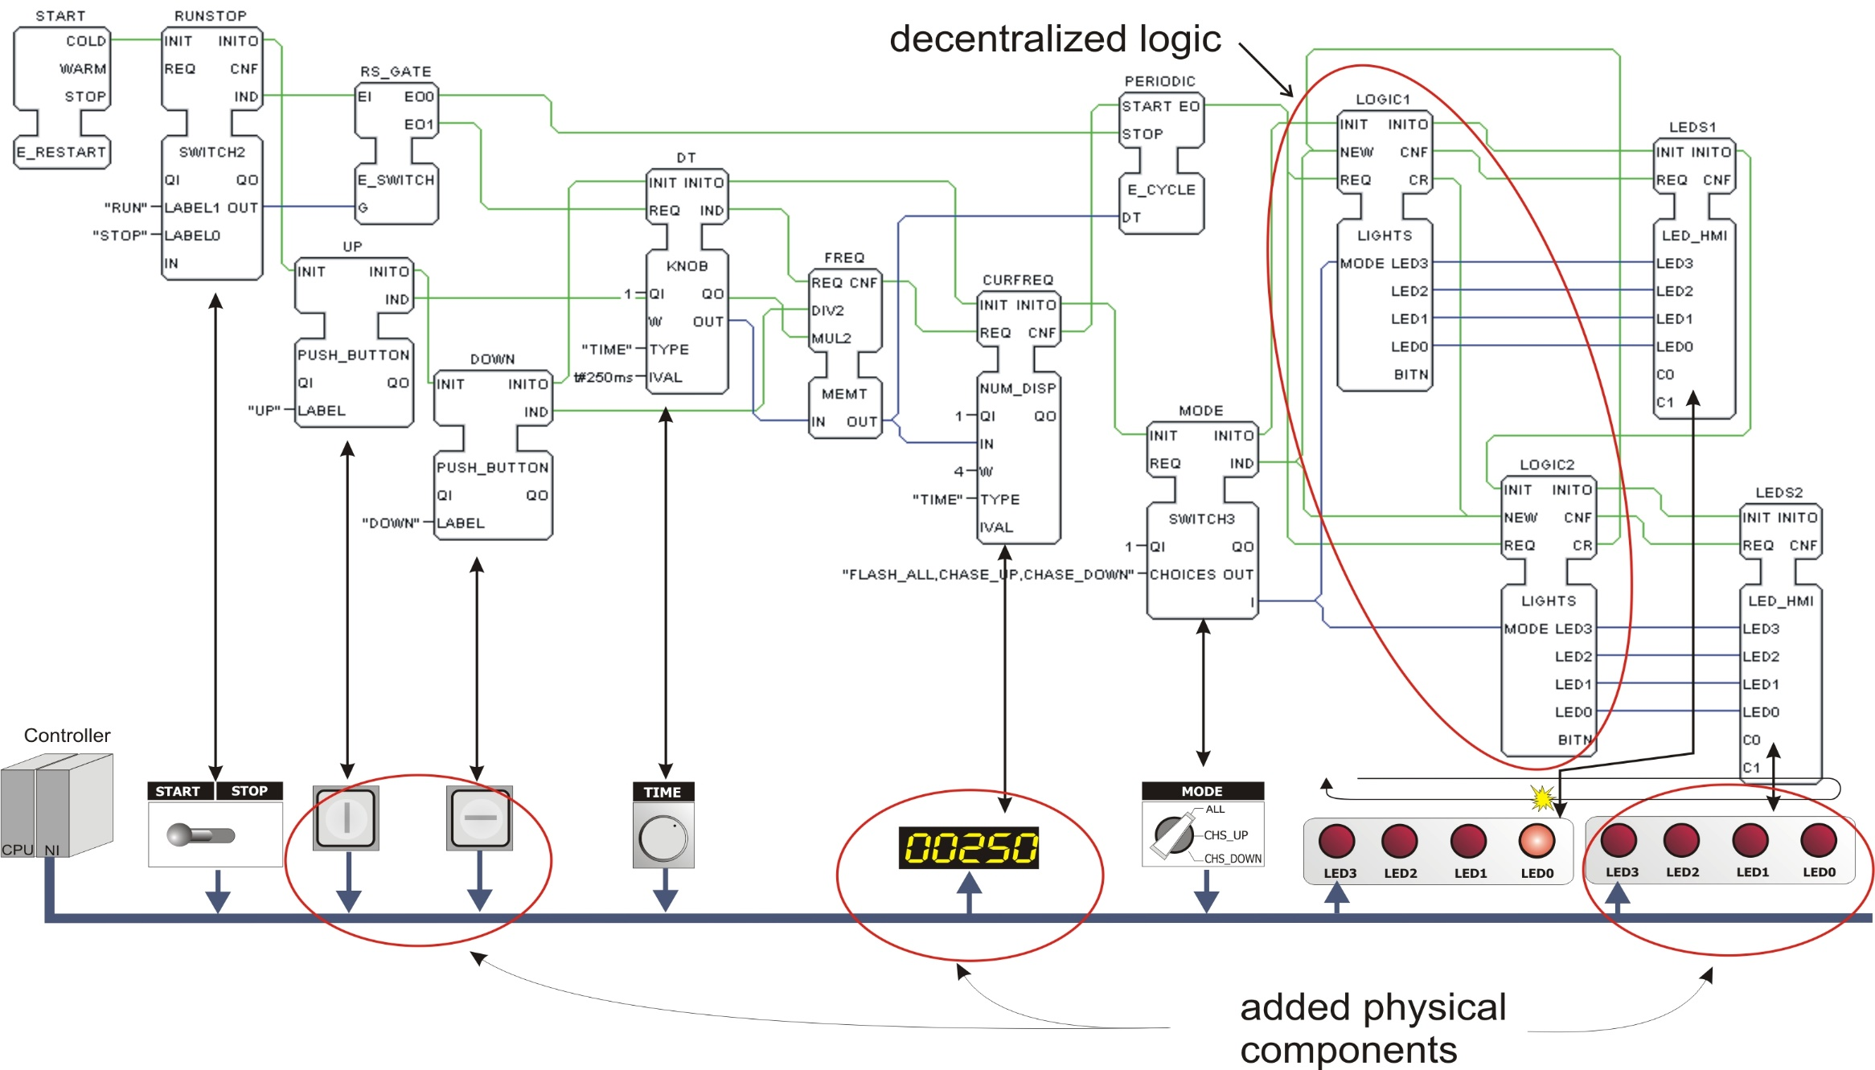
Extended system

Slide 12
Common elements

Slide 13
Parts of IEC 61499 Standard
IEC 61499-1:2012
Function blocks - Part 1: Architecture
IEC 61499-2:2012
Function blocks - Part 2: Software tool requirements
IEC TR 61499-3:2004
Function blocks - Part 3: Tutorial information (withdrawn)
IEC 61499-4:2013
Function blocks - Part 4: Rules for compliance profiles
Notes:
IEC 61499-4:2013 defines rules for the development of compliance profiles, which specify the features of IEC 61499-1 and 61499-2 to be implemented in order to promote the following attributes of IEC 61499-based systems, devices and software tools: - interoperability of devices from multiple suppliers; - portability of software between software tools of multiple suppliers; - and configurability of devices from multiple vendors by software tools of multiple suppliers. This second edition cancels and replaces the first edition published in 2005. It constitutes a technical revision and includes the following significant technical changes: Table B.1 has been updated for consistency with Table 8 of IEC 61499-1:2013.

Slide 14
Function Block Model: IEC 61131-3
_{DEBOUNCE}
_{BOOL}
_{IN}
_{OUT}
_{BOOL}
_{TIME}
_{DB_TIME}
External Interface Specification
Control Algorithm Specification
_{ON_TMR}
_{OFF_TMR}
_{TON}
_{IN}
_{TON}
_{OUT}
_{IN}
_{IN}
_{Q}
_{DB_FF}
|/|
_{IN}
_{Q}
_{(R)}
_{PT}
_{ET}
_{DB_TIME}
_{PT}
_{ET}
_{SR}
_{OFF_TMR}
_{S1}
_{Q1}
_{OUT}
_{ON_TMR}
_{TON}
_{R}
_{TON}
_{IN}
_{Q}
_{IN}
_{OUT}
_{DB_TIME}
_{PT}
_{ET}
| |
_{IN}
_{Q}
_{(S)}
_{DB_TIME}
_{PT}
_{ET}
Notes:
The Function Block in IEC 61499 is an extension to the FB in IEC 61131.
Let’s revise the FB model in IEC 61131 first. In IEC 61131, each FB consists of two parts: an external interface and a control algorithm.
The external interface only contain data signals. The control algorithm can be LD, ST, or a network of other FBs.
In additional to the data interface and control algorithm, events have been introduced to the FBs in IEC 61499.
This slide shows a typical IEC 61131 FB, which has an external interface with some data ports and the corresponding algorithms.
In 61499, FBs are event driven.

Slide 15
IEC 61131-3 and 61499 Data Types
Signed Integers: SINT(8), INT(16), DINT(32), LINT(64)
Unsigned Integers: USINT(8), UINT(16), UDINT(32), ULINT(64)
Floating Point: REAL(32), LREAL(64)
Bit Strings: BOOL(1), BYTE(8), WORD(16), DWORD(32), LWORD(64) (TRUE, FALSE, 1, 0, 255, 16#FF, etc.)
Character Strings: STRING(8)
Duration: TIME (t#2s, t#1500ms, etc.)
Time: TIME_OF_DAY or TOD DATE DATE_AND_TIME or DT (TOD#17:32:55.678 D#2005-06-07 DT#2005-06-07-17:32:55, etc.)
Derived Data Types: array, enumerated, structured, …
Notes:
Identical to IEC 61131-3

Slide 16
Function Block Type System
Library contains FB type definition
FB types can be instantiated later
Each FB instance can have its own
configuration/setting
Changes in FB types cause automatic changes on all instances
FBInstance2
FBInstance3
FBInstance1
FBType
FBType
FBType
Library of FB Types
FBType
Notes:
Once an FB is created, it will be stored in a library as an FB type. These FB types can be instantiated later in the actual design. Each FB instance can have its own configuration but the changes in the FB type will be automatically reflected to all the FB instances.

Slide 17
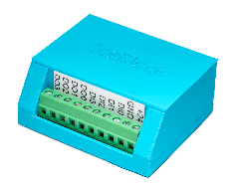

Motivation: Intelligent Automation Component
Cylinder Software Component
I1
?
O1
I2
O2
I3
O3

Slide 18
Communicating components
Cmp1
VAR
a: type1;
b: type2;
c: type3;
L: packet;
…
Cmp2
I1
L.form(Cmp2.I1,a,b);
O1.send(L);
…
O1
O2
L.form(Cmp3.I1,a,c);
O1.send(L);
…
Cmp3
O3
I1

Slide 19
Message=Event + associated Data
Cmp2
Cmp1
EI1
EO1
k
EO2
l
a
b
Cmp3
c
EI2
m
n

Slide 20


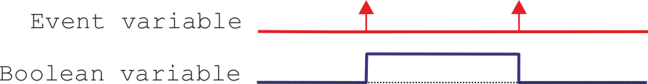
Events
Event
Event variables
Boolean
0 and 1
No duration (short duration)
IEC 61499 function block
can only be activated by an event
Event of crossing the line

Slide 21
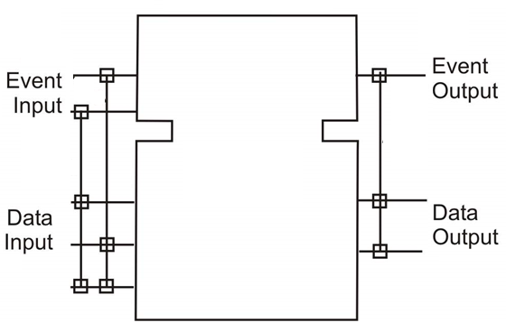
Function Block: Header and Body
Upper part of FB is called Header
Lower part of FB is called Body
Notes:
Reuse mechanism: Typing – Instantiation

Slide 22
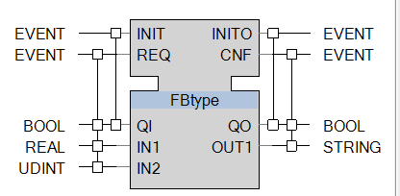
Function Block of IEC 61499: Interface
_{Event Inputs}
_{Event Outputs}
_{Head}
Event – data association: if the event occurs, only the associated data will be updated.
_{Body}
_{Data Inputs}
_{Data Outputs}

Slide 23
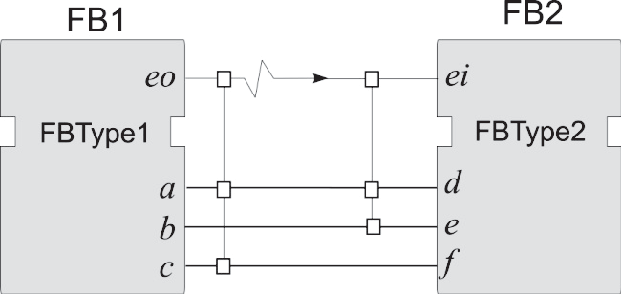
Function block: Event-Data Association
It is used to transfer data between FBs
Event output “eo” of FB1 is connected by an association line to the event input “ei” of FB2.
Once FB1 emits “eo”, it triggers the execution of FB2.
The values of input parameters “d” and “e” will be updated before the execution starts because they are associated with the event input “ei”.
1- FB1 emits event
3- event input is triggered
2- associated data outputs are updated ”on the line”
4- associated data inputs are sampled to FB2

Slide 24
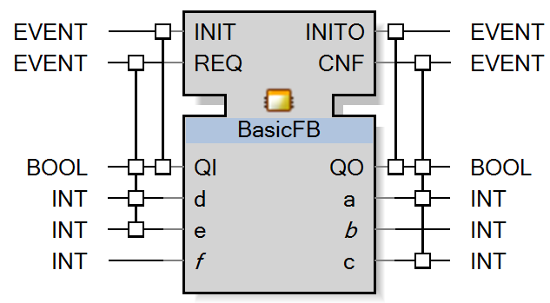
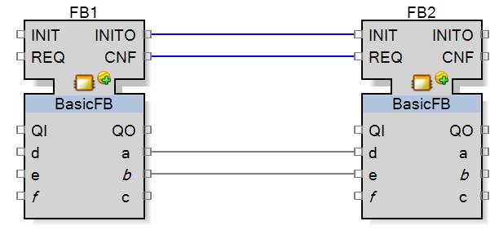
Event-data association

Slide 25
Event-data association
Two instances FB1 and FB2 of the same FB type
Suppose event FB1.CNF is emitted
FB1.a is updated and value is sent to FB2.d.
FB2.d is sampled
FB1.b is not updated (no association). Therefore FB2.e will not receive the updated value.
Instance Name

Slide 26

IEC 61499 Function Block Kinds
Basic, Composite, and Service Interface Function Blocks
Execution
Control Chart
Application
Resource
INIT(+)
startService
PARAMS
INITO(+)
Algorithms
STATUS
readInputs
IND(+)
RD_1,...,RD_n
STATUS
RSP(+)
writeOutputs
SD_1,...,SD_m
INIT(-)
endService
Internal
Variables
INITO(-)
STATUS
BFB
CFB
SIFB
Notes:
Under the same FB model, there are three different types or classes of FB defined in the standard. The first one is called Basic FB. As the name suggested, Basic FB is the fundamental building block which contains control logics. A Composite FB on the other hand is an encapsulation of FB network. Finally, SIFBs are system dependent FBs use to interface, for example, the hardware I/Os.
I will go through each of them in more detail next.

Slide 27
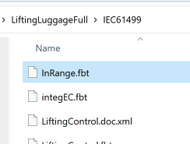
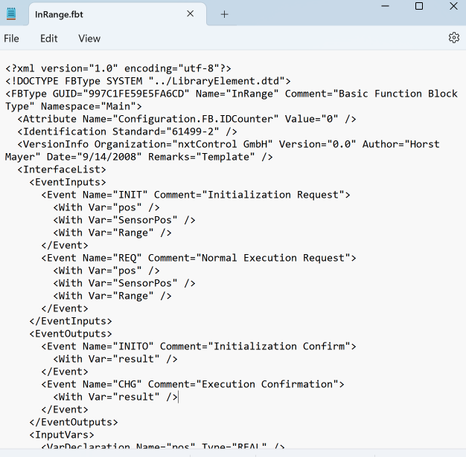
XML Exchange Format

Slide 28
Basic Function Block

Slide 29
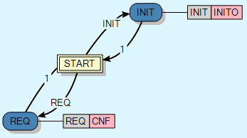
Basic Function Blocks
Event Input
Event Output
Execution
Control
Chart (ECC)
Data Input
Data Output
Algorithms
Algorithms can be programmed in PLC languages
Structured Text
Ladder Logic
etc.
Notes:
Basic FB consists of two major parts:
The execution control chart, which is kind of state machine defines the Basic FB’s control logics.
A set of algorithms controls the actual operations.
The execution semantics of Basic FB is as follows:
The execution of a Basic FB starts with the occurrence of an event input;
When an event input arrives, the associated data will be updated;
According to the event and data inputs, the corresponding state in the execution control chart will be activated;
And the related algorithms will be executed. The algorithms can be specified in any language as defined in IEC 61131, such as ST, LD, and so on;
Once the algorithms are completed the newly generated event and data outputs will be issued.
This slide shows a typical IEC 61131 FB, which has an external interface with some data ports and the corresponding algorithms.
In 61499, FBs are event driven.

Slide 30
Execution Control Chart (ECC)
EC State
EC Action
Event
Input
EC
Transitions
Event
Output
Algorithm
Boolean
Condition
Initial
EC State
EC State
Notes:
The most important thing in a Basic FB is the ECC, which is composed by a set of states with the initial state marked by a double square. Except for the initial state, each EC State can associate with a set of EC Actions. Each EC Action can have an Algorithm and the Event Output to be issued after the algorithm’s execution. The EC States are linked via the EC Transitions. The evaluation condition of the EC Transitions can be an event input, a Boolean condition, or a combination of both.

Slide 31
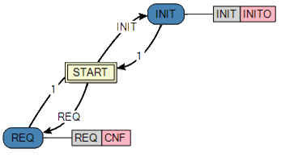
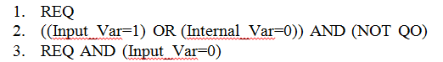
Transition conditions
Event
Input
A transition condition can be one of the following:
Guard
Condition
1
Event input
Boolean expression over data
Event input {&}[Boolean expression over data]
Boolean
Expression
Examples:
4. REQ [Input_Var=0]
New syntax

Slide 32
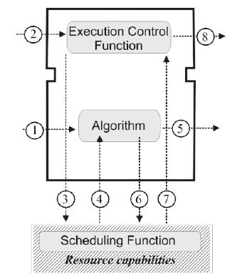
How does Basic Function Block work?
Step 1. The input variable values relevant to input event are made available
Step 2. The input event occurs, the execution control of the FB is triggered.
Step 3. The execution control function evaluates the ECC and notifies the scheduling function to schedule algorithm for execution.
Step 4. Algorithm execution begins.
Step 5. The algorithm completes the assignment of values for the output variables associated with the event output.
Step 6. The resource scheduling function is notified that algorithm execution has ended.
Step 7. The scheduling function invokes the execution control function.
Step 8. The execution control function signals event at the event output.
Notes:
The transition conditions are evaluated in the order they are declared in the textual representation of the block (i.e., in XML).

Slide 33
How does Basic Function Block work?
EVENT
INIT
INITO
EVENT
EVENT
REQ
CNF
EVENT
0
LOGIC
1
BOOL
QI
QO
1
2
INT
PARAMS
RES1
BOOL
BOOL
A
RES2
BOOL
BOOL
B
BOOL
C
SHUT
SHUT
CNF
REQ & (PARAMS=2)OR(QI=0)
ACTIVE:=0
RES1:=0 RES2:=NOT B
QO:=0
1
START
1
REQ&(PARAMS=1)&ACTIVE
A
B
RES1
INIT
] [
] [
( )
1
C
]/[
INIT
INIT
INITO
MAIN
MAIN
CNF
A
B
RES2
] [
] [
( )
RES1
ACTIVE:=1
RES1:=0 RES2:=0
QO:=1
]/[

Slide 34
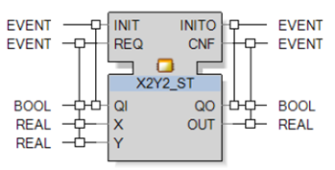
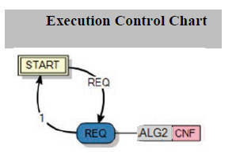
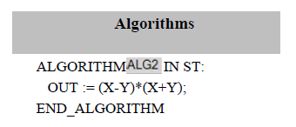
Basic FB – execution control chart (ECC)
Each state of ECC can have one or more actions.
An action may have an algorithm call and an output event emission, or both.
Basic concepts of fbDA

Slide 35
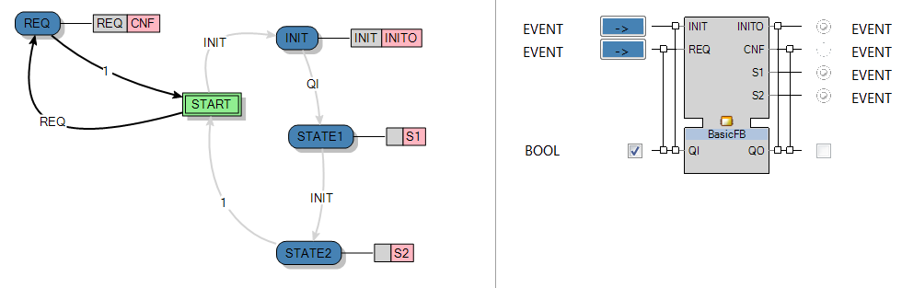
Lifetime of Event Input
EAE stops ECC execution when:
There are no enabled transition conditions which have not been executed already in this run
Trick: assign an algorithm, ALG1, to STATE1, within which set INIT:=False. This workaround is not portable.

Slide 36
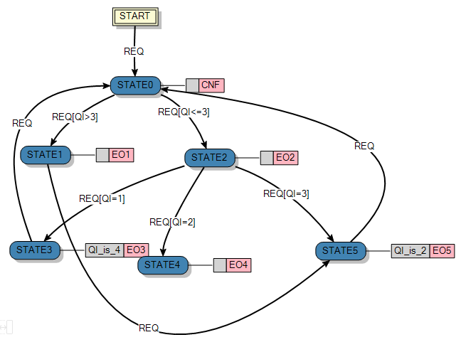
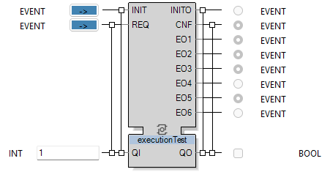
Lifetime of Event Input
The first transition with a true condition is executed and the corresponding ECC status of the block is occupied.
The recently used transition is marked so that it cannot be used a second time.
Once there are no transitions to other ECC states left to be fired, because they are already marked and thus executed, or none of the remaining, unmarked transition conditions proves to be true, the markings of the transitions is reset.
FB is waiting for next input event

Slide 37
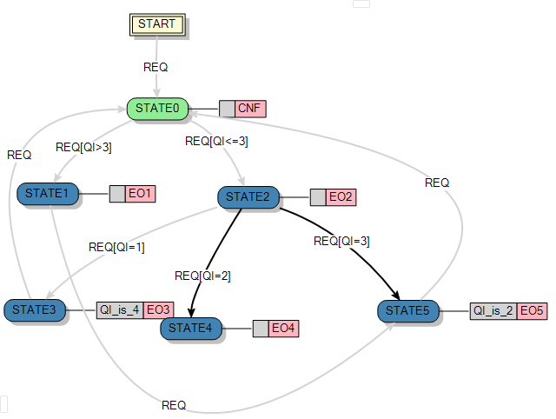
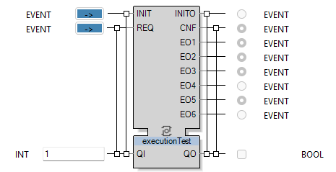
Lifetime of Event Input
1
5
2
7
4
3
6
1
4
7
5
2
3
6

Slide 38
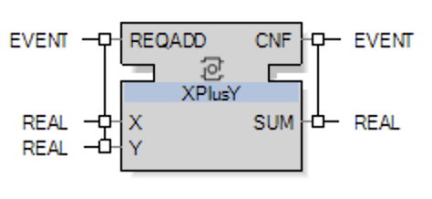
Example: A Basic FB that adds two real numbers

Slide 39
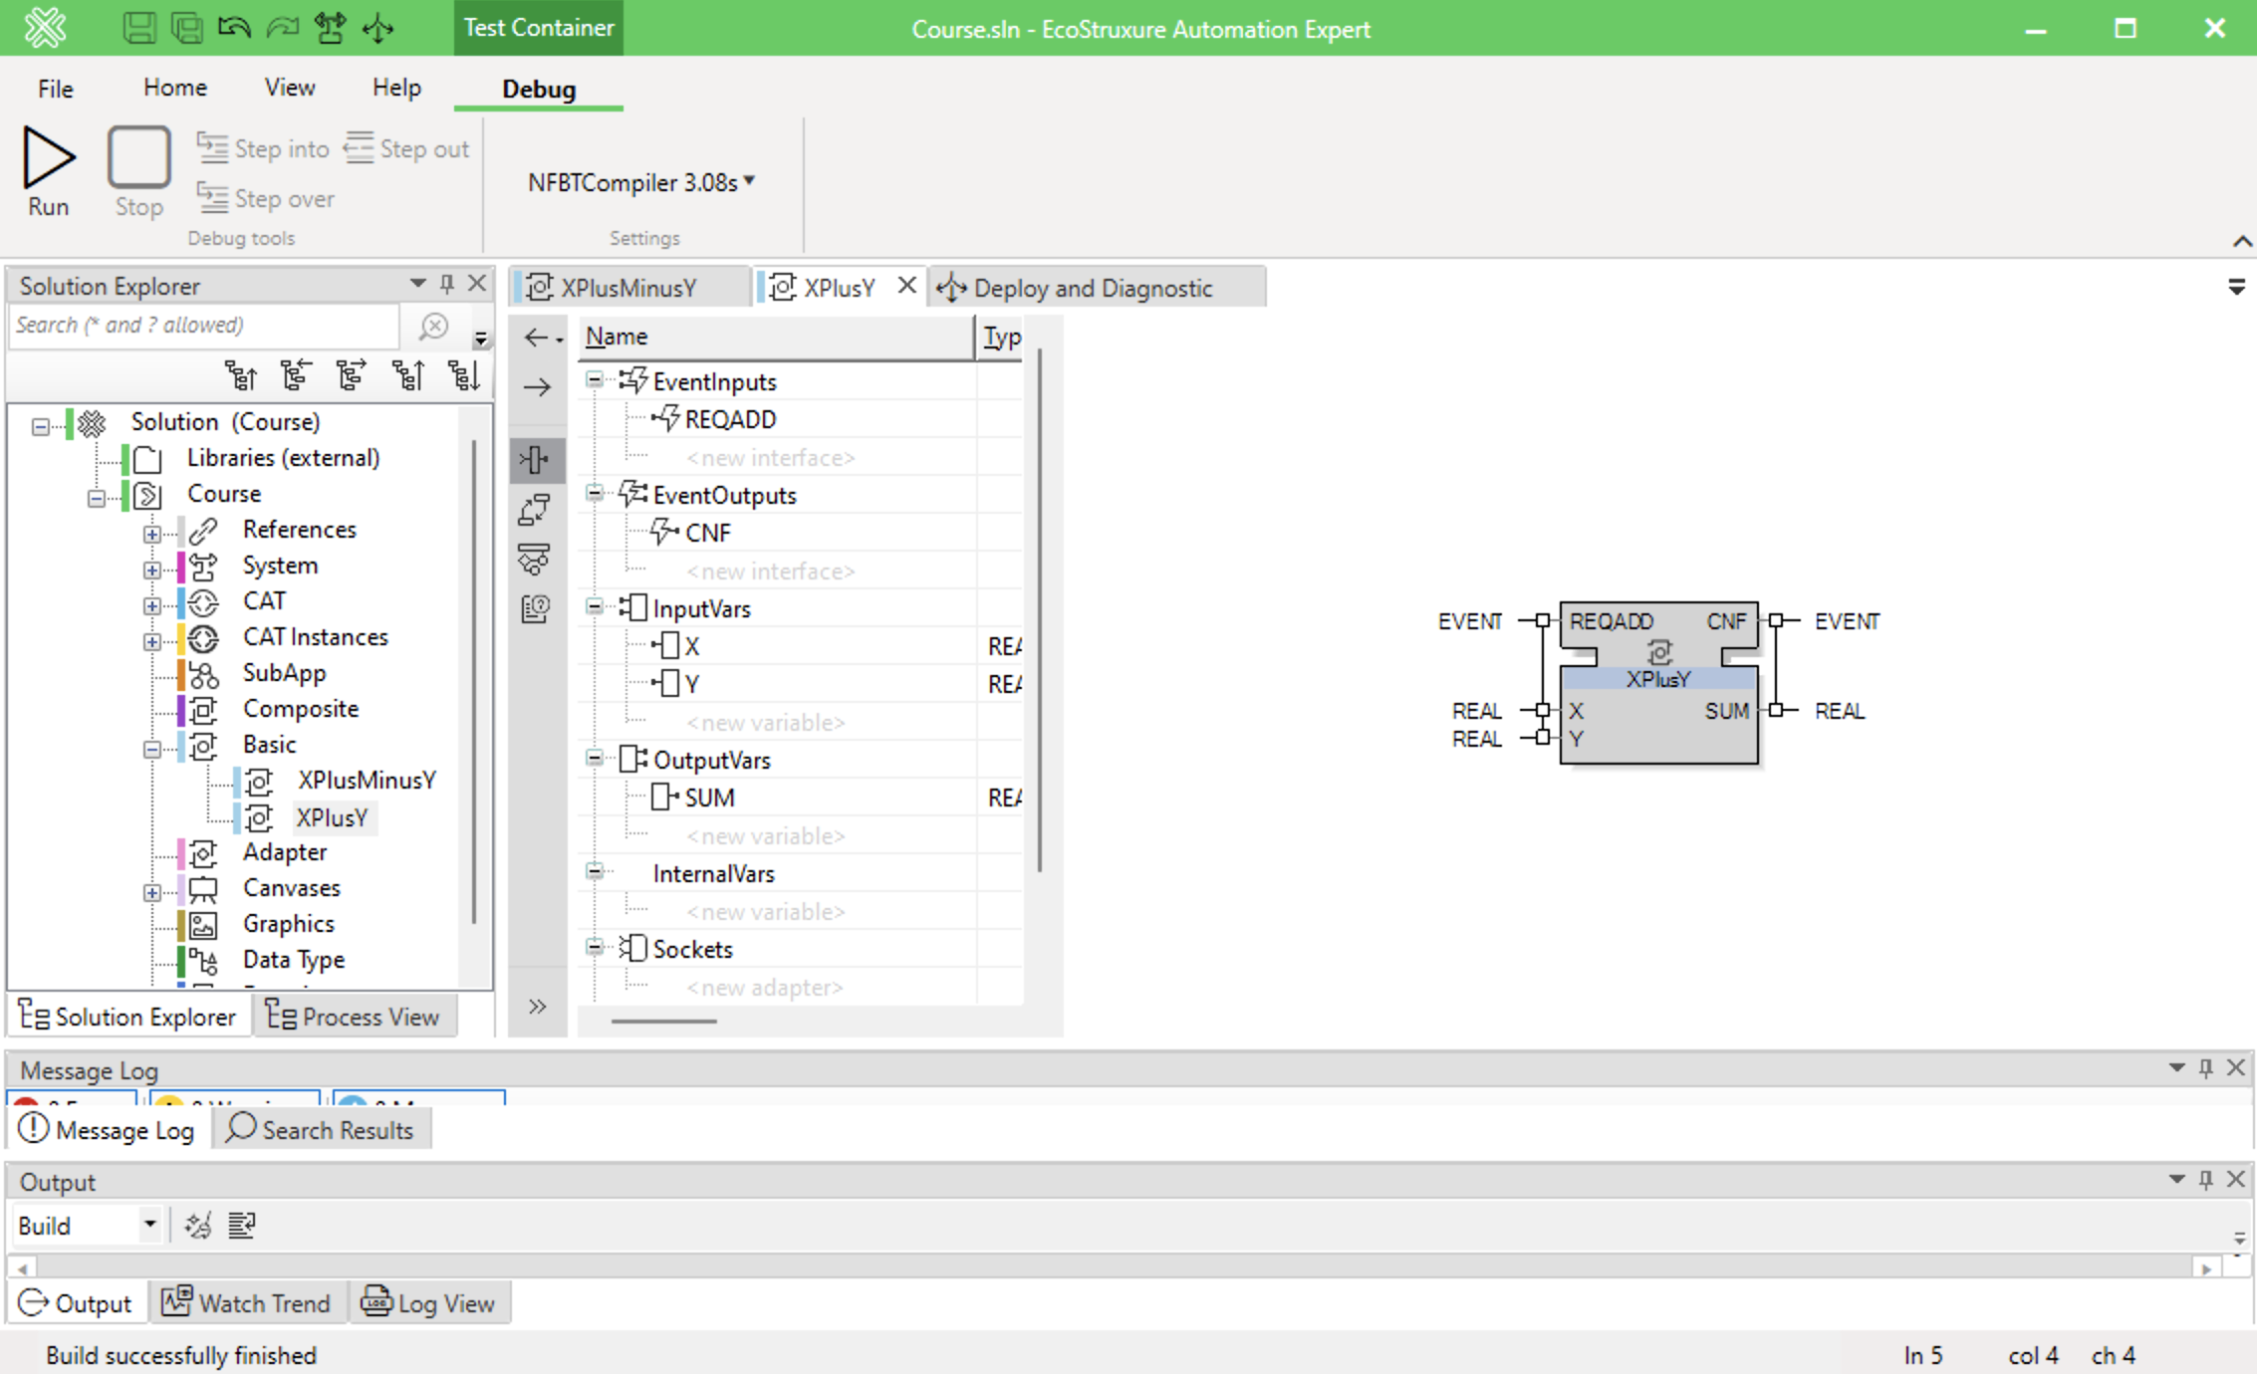
A Basic FB to add Two Real Numbers

Slide 40
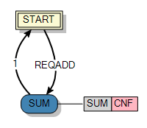
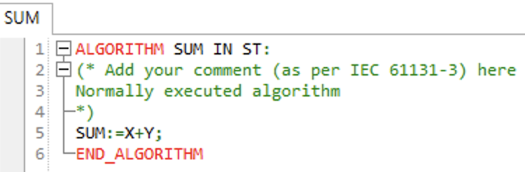
A Basic FB to Add Two Real Numbers

Slide 41
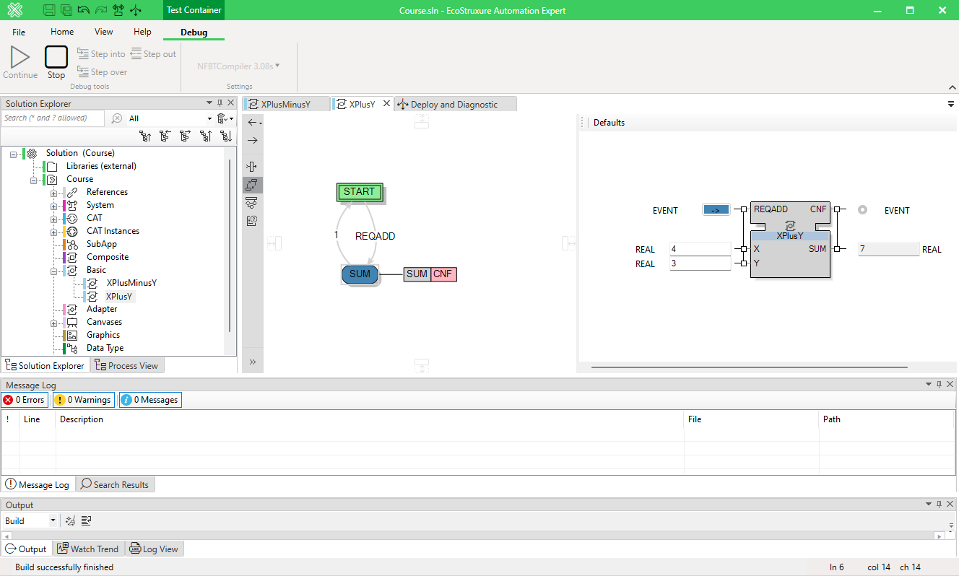
Running the basic FB to Add Two Real Numbers

Slide 42
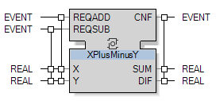
A Basic FB to Add and Subtract Two Real Numbers
extend

Slide 43
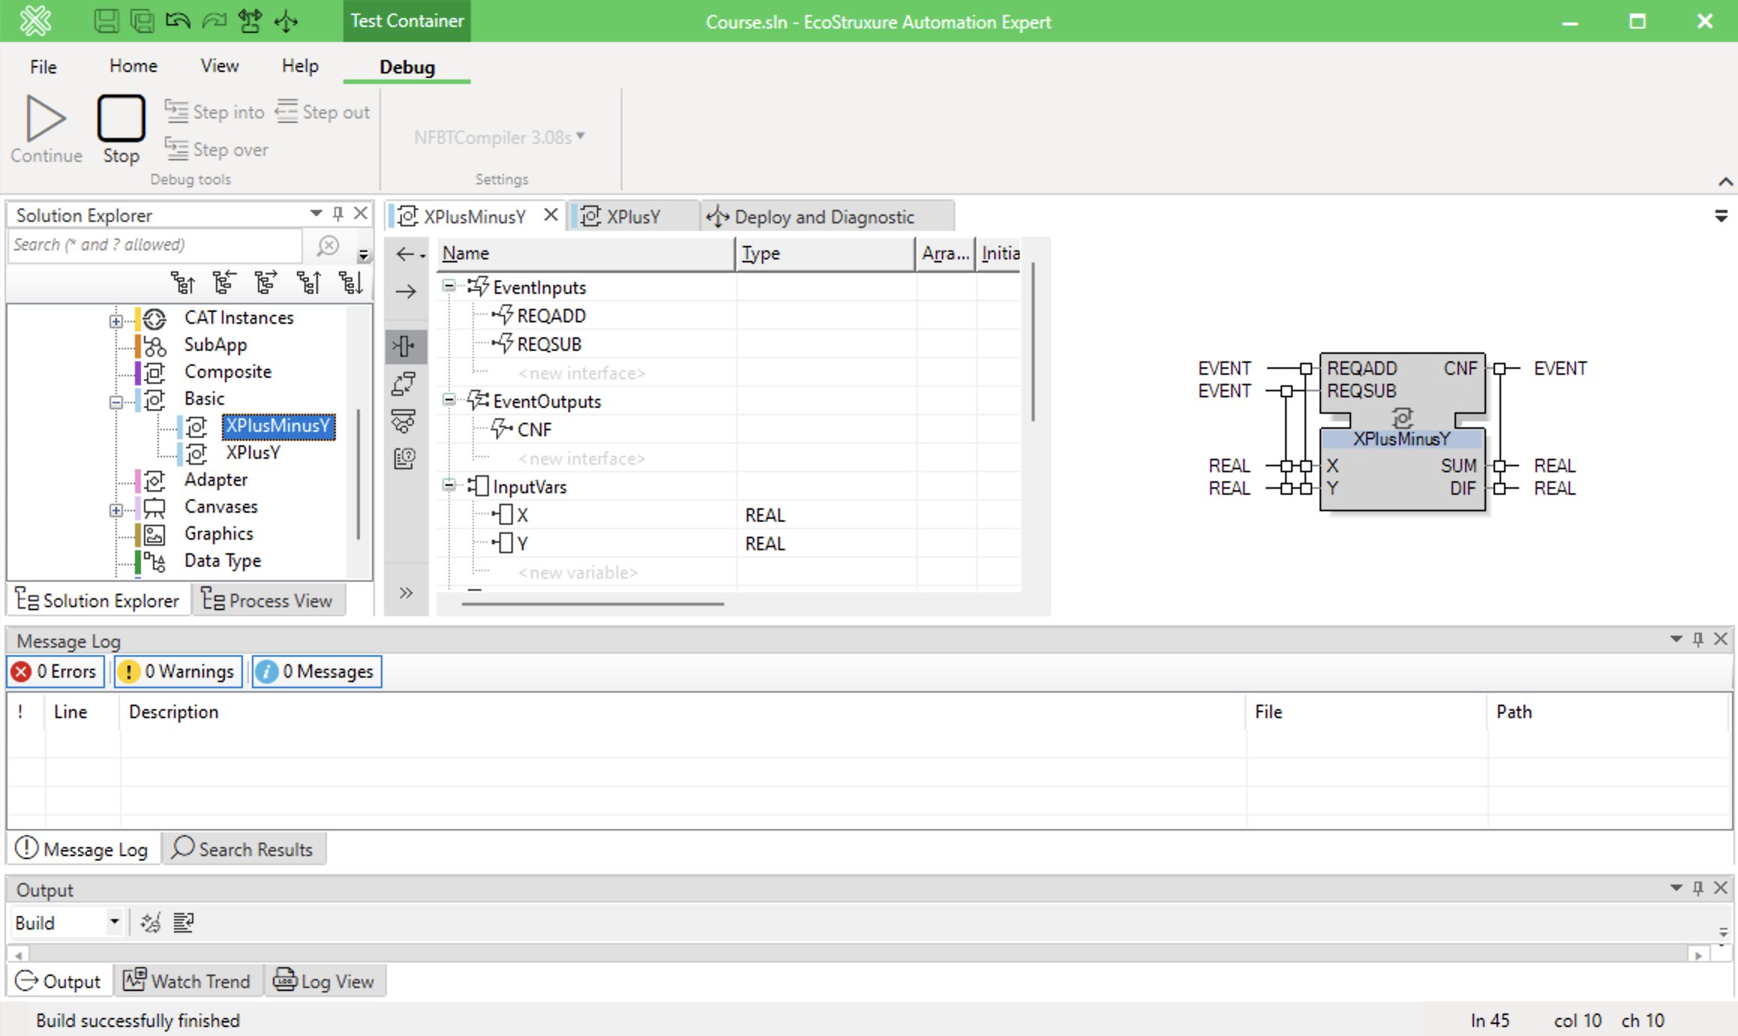
A Basic FB to Add and Subtract Two Real Numbers

Slide 44
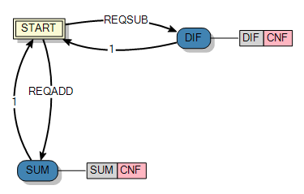
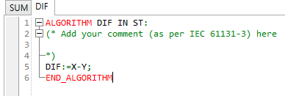
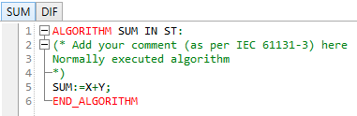
A Basic FB to Add and Subtract Two Real Numbers

Slide 45
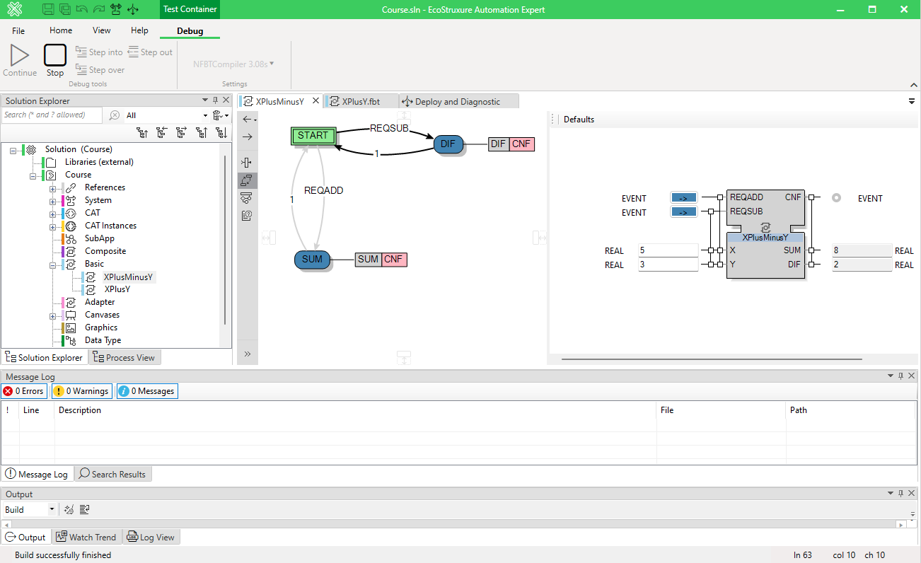
A Basic FB that Adds and Subtract 2 Real Numbers

Slide 46
Composite Function Block

Slide 47
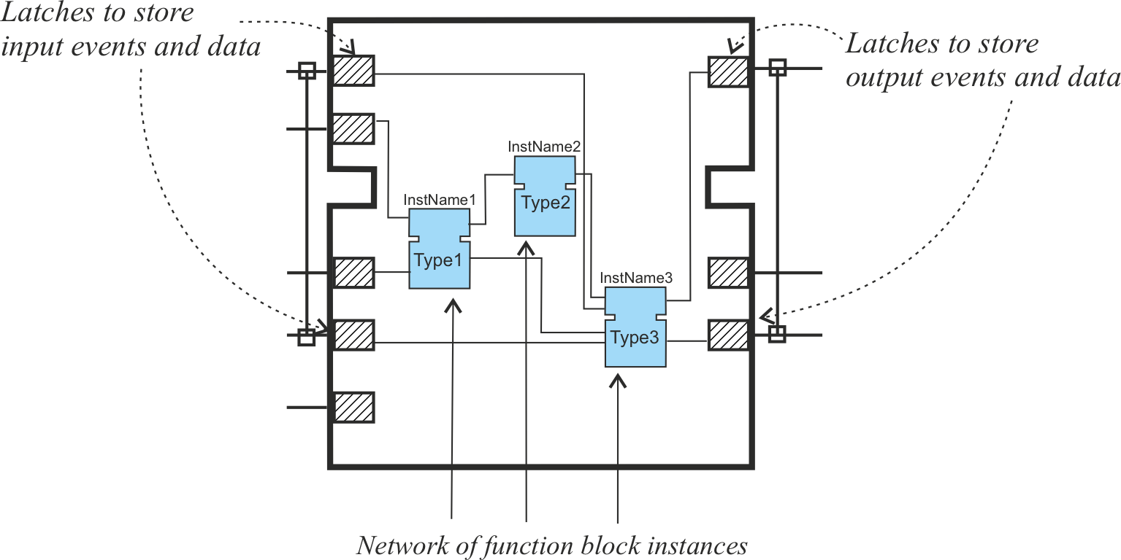
Composite Function Block
Network of interconnected FBs
No internal variables
Latches storing the values of input and output events and data
Nested composite-in-composite

Slide 48
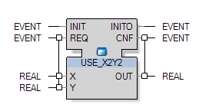
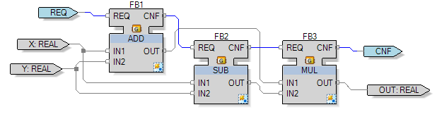
Composite Function Block: Example
Computing OUT = X² – Y²
Interface
Implementation
Event
Data

Slide 49
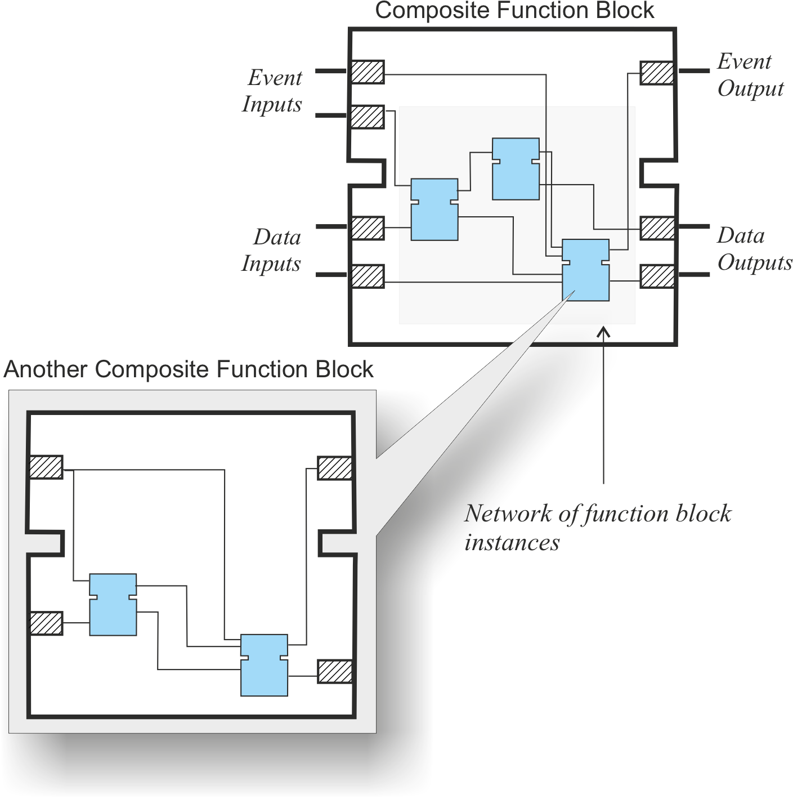
Hierarchical composition

Slide 50
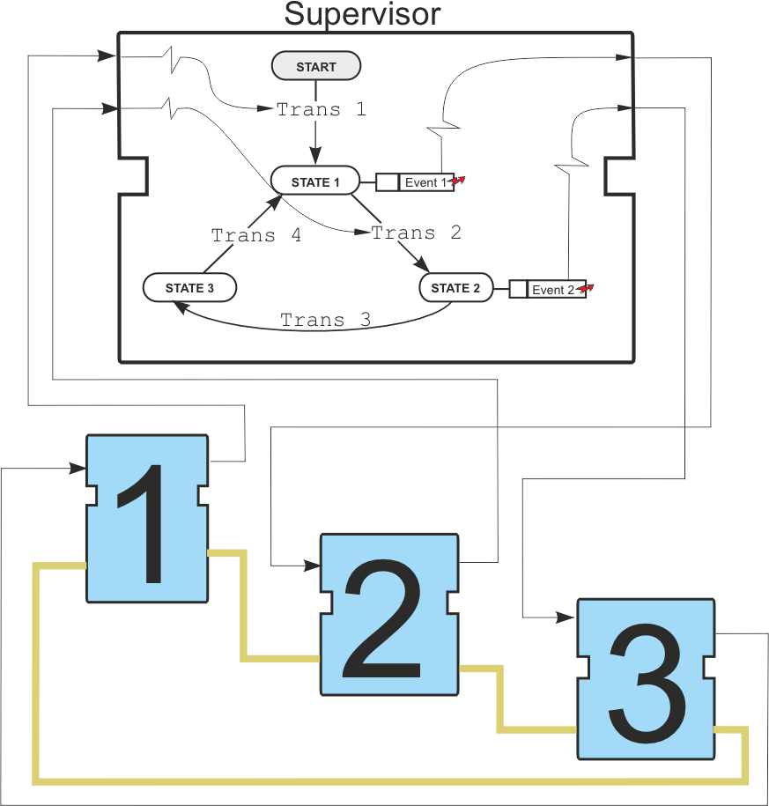
Composite Function Block
Execution Control:
No ECC
No internal variables
To ensure a particular order of execution, user can implement a supervisor basic function block

Slide 51
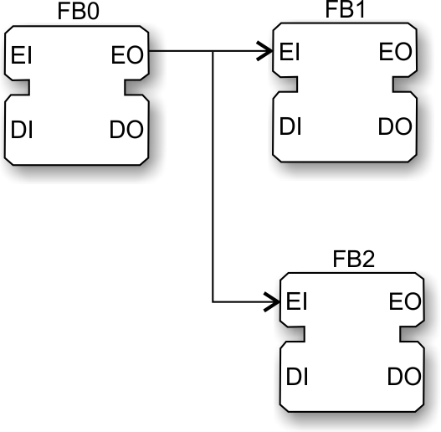
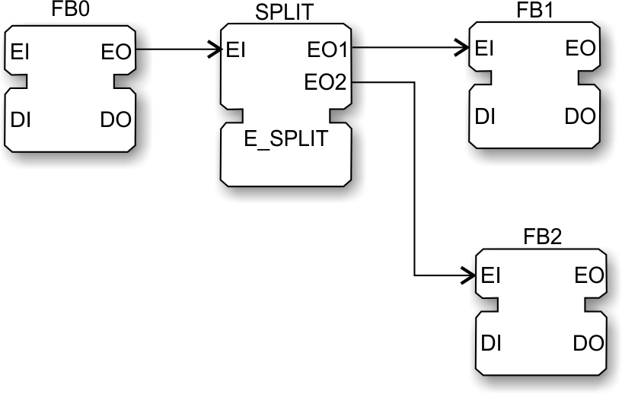
Rules for event connections
Event split is equivalent to using E_SPLIT standard library FB
=
Basic concepts of fbDA

Slide 52
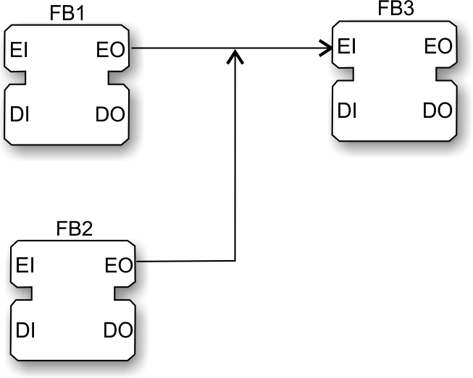
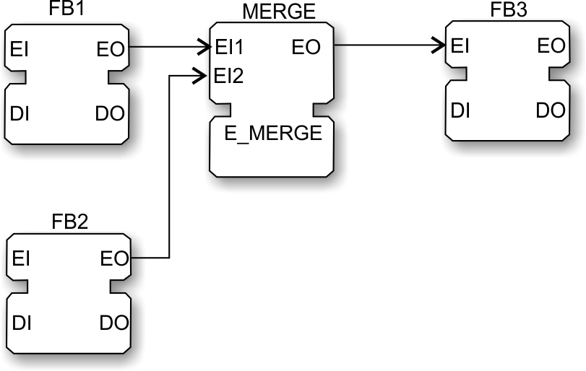
Event merge
Event merge is equivalent to using E_MERGE standard library FB
=
Basic concepts of fbDA

Slide 53

Data connections
Data connections – cannot be merged, but data split is allowed.
Basic concepts of fbDA

Slide 54
Service Interface Function Block

Slide 55






Service interface function blocks (SIFB)
Mechanisms for interacting with hardware resources
PC and different vendor printers – need drivers to command printer to print and get status information
Similar with SIFB – to get data from sensors and PLCs, and control actuators
SIFB implementation requires low level knowledge of particular hardware
Provided by vendor
Encapsulation of IP
HP, DELL, EPSON, CANON, XEROX, Konika Minolta, RICOH
drivers

Slide 56

Service Interface Function Blocks (SIFB)
Modelled as sequences of service primitives per ISO TR 8509
Notes:
Binary code

Slide 57


Operations with events

Slide 58


Process interface: read inputs and write outputs

Slide 59
Elements of Distributed systems

Slide 60
Resource Model
The main execution container of FB network
Each Resource is independent of other Resources in the device
Access to Communication and Process interfaces via SIFBs
Responsible for the scheduling of FBs
Communication interface(s)
Communication mapping
SFB
FB Network
SFB
Process
mapping
Scheduling Function
Process interface(s)
Notes:
Above the FB model is the Resource Model, which contains an FB network and provides it the access to communication and process interface via SIFBs. Each Resource also comes with a Scheduling Function to schedule the execution FBs inside the FB network.

Slide 61


Resources – scheduling functions
Schedule algorithms for execution
Determines sequence
Of FBs execution
Of algorithms execution

Slide 62

Device Model
An abstract model represents a physical instrument interacting with automation systems or process information, e.g.
PLC, CNC, microcontroller, etc.
Notes:
Resources are further contained in Devices, which represent physical instruments such as a computer or a microcontroller and etc. Each device can contain multiple Resources and all Resources use the same communication and Process interfaces of the Device.
Process interface is the mapping between the physical entities (sensors, actuators) and the resource

Slide 63
Device Model
A Device is specified by it process interfaces and communication interfaces
Process interface is the mapping between the physical entities (sensors, actuators) and the Resource
Contains multiple Resources
All Resources use the same Communication and Process interfaces of the Device
Communication interface(s)
Resource 1
Resource 2
Resource 3
Application A
Application B
Application C
Process interface(s)
Notes:
Resources are further contained in Devices, which represent physical instruments such as a computer or a microcontroller and etc. Each device can contain multiple Resources and all Resources use the same communication and Process interfaces of the Device.
Process interface is the mapping between the physical entities (sensors, actuators) and the resource

Slide 64



Device model: example of use

Slide 65



Device classes
Class 0:
Preprogrammed FB instances
FBs connections can be changed
Class 1
New instance of FB library
Class 2
Fully reprogrammable
Can create FB types

Slide 66



Device type definition
Interface of the device may have only data inputs.
Example: SE.DPAC.M251_dPAC
Deployment IP Address:Port
HMI IP Address:Port
Watch IP Address:Port
Archive Service IP Address:Port

Slide 67


Resource type definition
EMB_RES_ECO, PANEL_RESOURCE, VIEW_RES
Default function block START of E_RESTART

Slide 68



Device management
By default, devices contain resource MGR
KERNEL of TYPE DM_KRNL
Executes received management commands
Configuration tool manages the device

Slide 69

Device management
Dev_MGR receives commands in XML
Replies back with confirmation or errors

Slide 70


Device management
Dev_MGR receives commands in XML
Replies back with confirmation or errors

Slide 71
Application
Application is a design artefact
Consists of a network of FBs
Designed independently from hardware where it will be deployed to
Deployment: mapped to one or several devices
Notes:
Applications are design artifacts which consists an FB network contains the entire design. Applications are designed independent from hardware and can be mapped totally or partially across different Devices.

Slide 72

Application: Example

Slide 73


Subapplication
Type definition, like for function blocks
Interface, but without event-data associations
Defined by a function block network, like Composite FB
No latching of events and data,
direct propagation

Slide 74
System Configuration
Represents the physical deployment of the design
Consists of:
Communication network
Devices
Controlled process and machines
Communication network
Device 1
Device 2
Device 3
Device 4
Application A
Appl. C
Application B
Controlled process/machines
Notes:
The top-level model in IEC 61499 is call System, which represents the physical deployment of the design and consists of communication network, devices, and the controlled process and machines. As you can see from this diagram, there are three entities called Applications in the System.

Slide 75
Distribution of Application
Event flow
Application can be deployed to several devices
A device in the system can contain and execute parts of different applications
Application =
Function Block Network
Data flow
Communication network
System = Communication Network + Devices +
Process/Machines
Device 1
Device 2
Device 3
Device 4
Application A
Appl. C
Application B
Controlled process/machines
Notes:
For instance, Application A is mapped to three Devices in this System.

Slide 76


Distribution of Application
Tools usually insert the communication blocks automatically
Notes:
Communication between devices
Tools usually insert the communication blocks automatically
Or one can insert them manually using the PUBLISH and SUBSCRIBE function block types included as part of the standard library

Slide 77


Example: Distributed systems configuration

Slide 78
Example: Distributed systems configuration

Slide 79
Composite Automation Type (CAT)

Slide 80


Composite Automation Type (CAT)
Object-oriented mechanism of creating visualisation for automation projects
Object-oriented
Self-contained
Reconfigurable
Each CAT consists of:
Visualization symbols
Control logic
Plant models
HMI and I/O connections
Supports:
Direct hardware interaction
Automatic deployment of control logic
Notes:
FBs can be designed following many patterns. One popular pattern is called CAT, which follows the well-known MVC design pattern from software engineering.
Each CAT consists of …
You have learned design patterns for PLCs.
You will also learn design patterns for distributed systems.

Slide 81

CAT
Software representation of real instruments/devices, e.g. pump
Predefined control structure with abstract hardware interface
Automatic HMI configuration and connection

Slide 82
System architecture with an implicit HMI device

Slide 83


Application with CATs

Slide 84

Model of Composite Cylinder

Slide 85
CAT creation

Slide 86

How does a CAT work?

Slide 87
Normal establishment

Slide 88
Normal operation

Slide 89
Normal termination

Slide 90
Operation is inhibited

Slide 91
Event-handling Function Blocks

Slide 92


Count UP
UINT
BOOL
UINT
Algorithm
Action
Output event

Slide 93


Count down
UINT
BOOL
UINT

Slide 94


Count UP/Down
UINT
BOOL
BOOL
UINT

Slide 95


E_CYCLE
TIME

Slide 96


Data latch
BOOL
BOOL
CLK
D
EO
Q

Slide 97


Event switch E_SWITCH
BOOL
EI
G
EO0
EO1

Slide 98


Event demultiplexor
UINT

Slide 99


Boolean falling edge detection
BOOL
EI
QI
EO

Slide 100


Boolean raising edge detection
BOOL
EI
QI
EO

Slide 101


E_MERGE

Slide 102


Train of events

Slide 103


E_TABLE_CTRL
TIME[4]
TIME
UINT
UINT
In this example N<=4

Slide 104


Table-driven sequence of events
TIME[4]
UINT
UINT

Slide 105


Controlled Event propagation E_PERMIT
BOOL

Slide 106



Slide 107



RS, SR triggers
BOOL
BOOL

Slide 108


Event selector
BOOL

Slide 109


Event splitter

Slide 110


Event driven toggle of a Boolean output
BOOL

